Slide 1

School of Computing Science and Engineering
Course Code : BSCS1240 Name: Object Oriented Programming with C++
UNIT I
Introduction: Basic Terminology
Introduction to C++
Name of the Faculty: Lalit Sharma Program Name :BSC

Slide 2
Objective
Objective of this lecture -
Introduction to C++
Features & Applications
Setting up C++ Development Environment

Slide 3
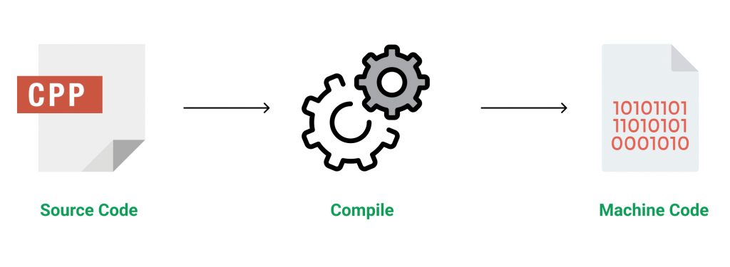
Introduction to C++
Introduction to C++
C++ is a general-purpose programming language that was developed as an enhancement of the C language to include object-oriented paradigm. It is an imperative and a compiled language.
C++ is a middle-level language rendering it the advantage of programming low-level (drivers, kernels) and even higher-level applications (games, GUI, desktop apps etc.). The basic syntax and code structure of both C and C++ are the same.

Slide 4
Features of C++
Introduction to C++
Some of the features & key-points to note about the programming language are as follows:
Simple
Machine Independent but Platform Dependent
Mid-level language
Rich library support
Speed of execution
Pointer and direct Memory-Access
Object-Oriented
Compiled Language

Slide 5
Applications of C++
Introduction to C++
C++ finds varied usage in applications such as:
Operating Systems & Systems Programming. e.g. Linux-based OS (Ubuntu etc.)
Browsers (Chrome & Firefox)
Graphics & Game engines (Photoshop, Blender, Unreal-Engine)
Database Engines (MySQL, MongoDB, Redis etc.)
Cloud/Distributed Systems

Slide 6
Setting up C++ Development Environment
Introduction to C++
Using online IDE: IDE stands for integrated development environment. IDE is a software application that provides facilities to a computer programmer for developing software.
There are many online IDEs available which you can use to compile and run your programs easily without setting up a local development environment.
Codechef
Ideone
Codingblocks
Setting up local environment: For setting up your own personal development environment on your local machine you need to install two important software:
Text Editor
C++ Compiler

Slide 7
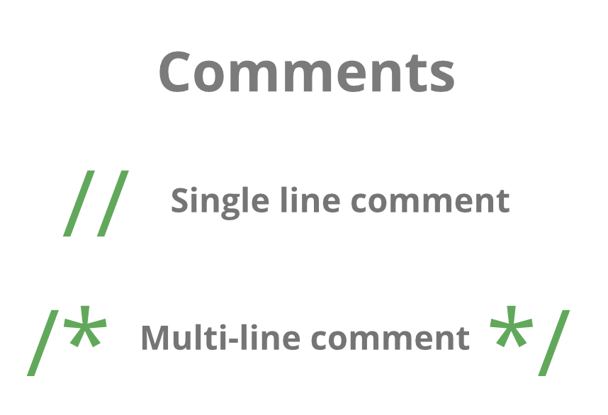
Comments in C++
Introduction to C++
A well-documented program is a good practice as a programmer. It makes a program more readable and error finding become easier. One important part of good documentation is Comments. In computer programming, a comment is a programmer-readable explanation or annotation in the source code of a computer program
Comments are statements that are not executed by the compiler and interpreter.
In C++ there are two types of comments :
Single line comment
Multi-line comment

Slide 8
Basic Input / Output in C++
Introduction to C++
C++ comes with libraries that provide us with many ways for performing input and output. In C++ input and output are performed in the form of a sequence of bytes or more commonly known as streams.
Input Stream: If the direction of flow of bytes is from the device(for example, Keyboard) to the main memory then this process is called input.
Output Stream: If the direction of flow of bytes is opposite, i.e. from main memory to device( display screen ) then this process is called output.
The two keywords cout in C++ and cin in C++ are used very often for printing outputs and taking inputs respectively. These two are the most basic methods of taking input and printing output in C++. To use cin and cout in C++ one must include the header file iostream in the program.

Slide 9
Writing first C++ program : Hello World example
Introduction to C++
// Simple C++ program to display "Hello World"
#include<iostream>
using namespace std;
int main()
{
cout<<"Hello World";
return 0;
}

Slide 10
Summary
The name of C++ signifies the evolutionary nature of the changes from C. “++” is the C increment operator.
C++ is one of the predominant languages for the development of all kind of technical and commercial software.
C++ introduces Object-Oriented Programming, not present in C. Like other things, C++ supports the four primary features of OOP: encapsulation, polymorphism, abstraction, and inheritance.
C++ got the OOP features from Simula67 Programming language.
A function is a minimum requirement for a C++ program to run.(at least main() function)
Program Name: BSC

Slide 11
References
Object Oriented Programming with C++ - Rajiv Sahay, Oxford Mastering C++ - Venugopal, McGraw-Hill Education (India)
Herbert Schildt, C++ - The Complete Reference, Third Edition -Tata McGraw Hill - 1999.
Bruce Eckel, Thinking in C++, Second Edition, Volume One, Pearson Education Asia, 2000.
Program Name: BSC

Slide 12
Contact Information
Lalit Sharma
Lalit.sharma@galgotiasuniversity.edu.in
Program Name: BSC

Slide 13


